Slide 1
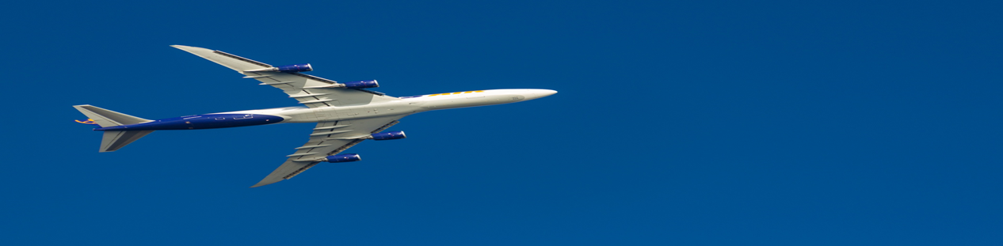
IS - 669
Big Data and Information Systems
Project Phase 1

Slide 2
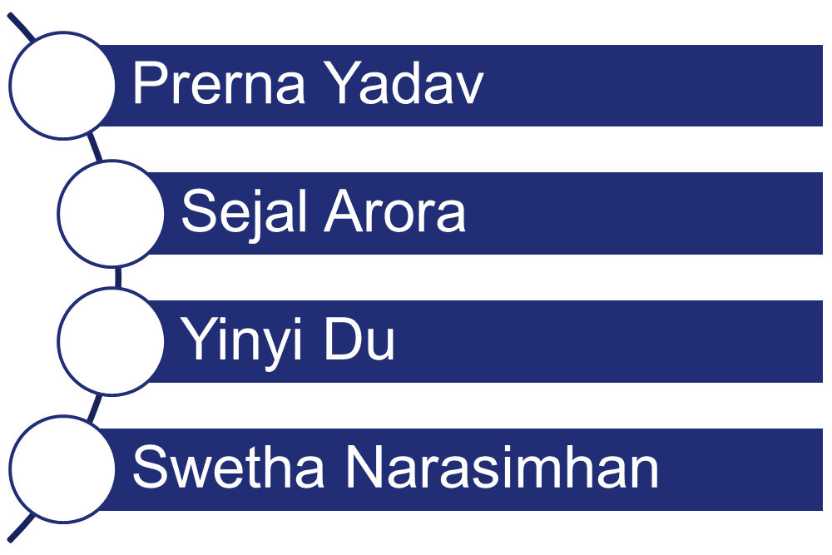
Team Members

Slide 3
Objective
To analyze, visualize and solve the following problem statements based on the assigned year:
Determine the three airports with the highest delay time (in hours)
Determine the three carriers with the highest delay time (in hours)
Determine overall which type of delay (arrivals or departures) is the largest for carriers.

Slide 4
Name : Yinyi Du
Year: 2007

Slide 5
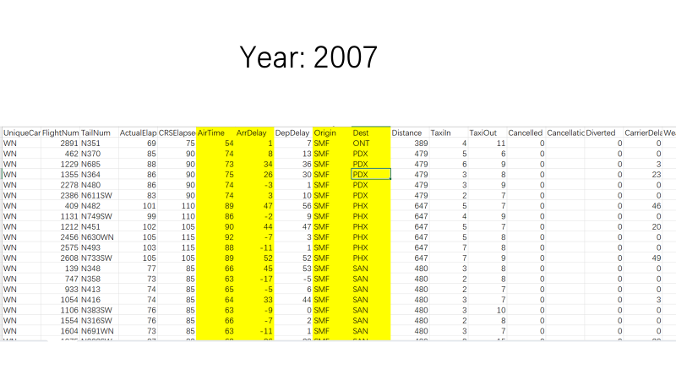

Slide 6
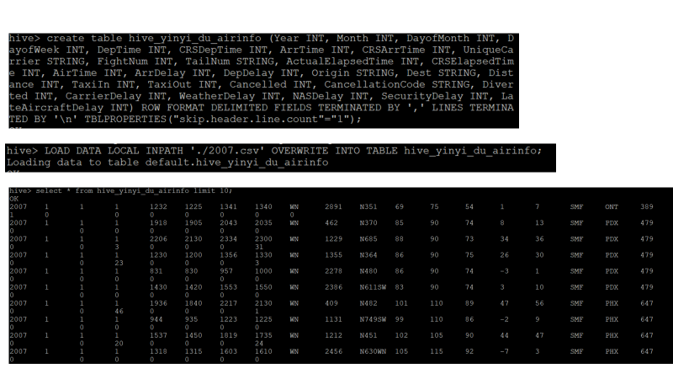

Slide 7
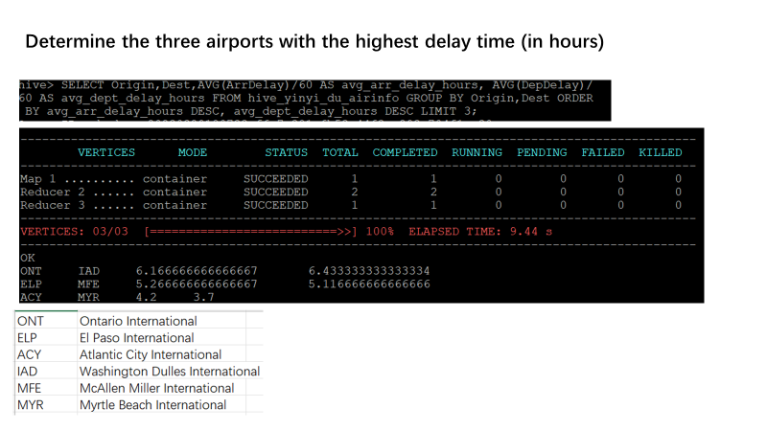

Slide 8
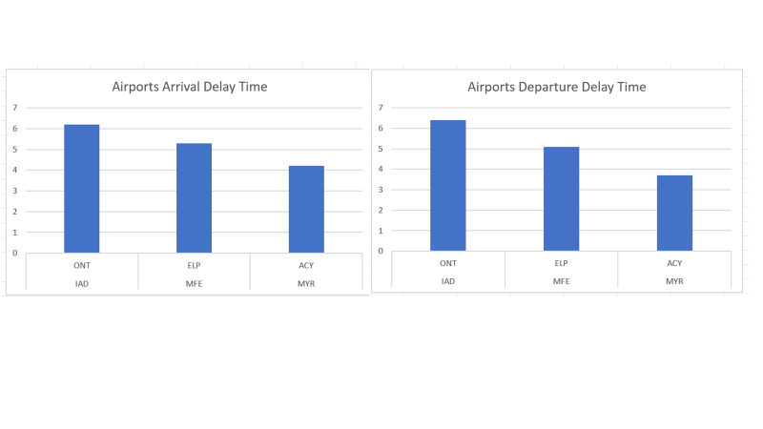

Slide 9
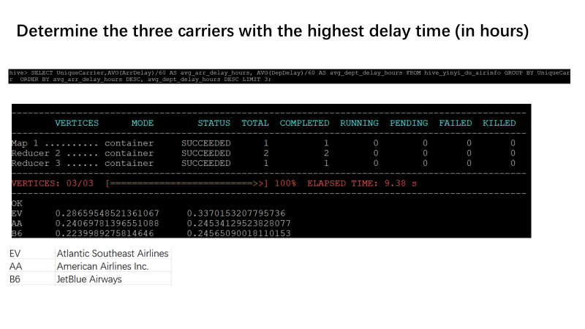

Slide 10
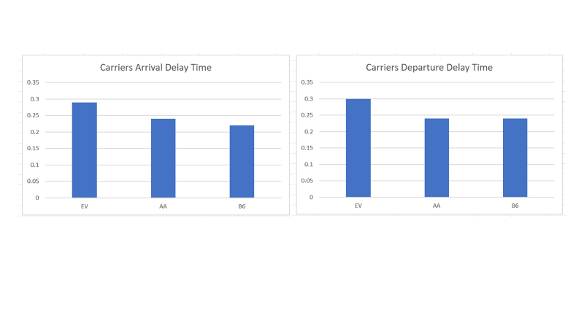

Slide 11
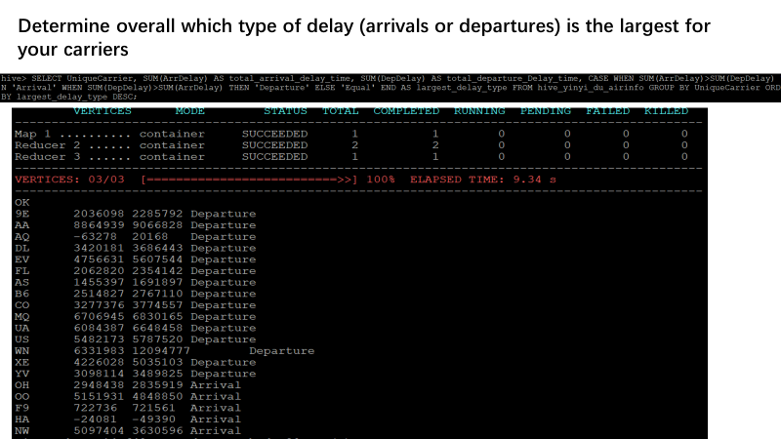

Slide 12
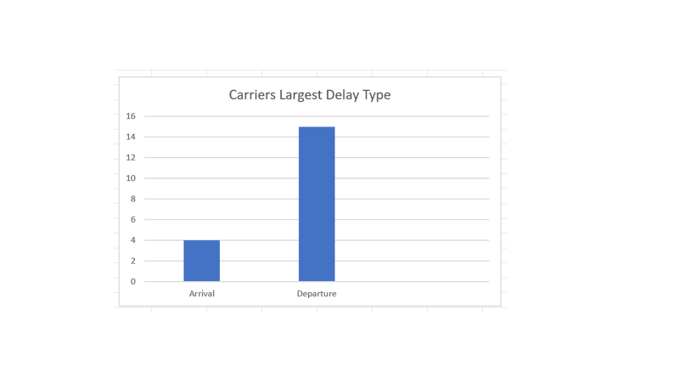

Slide 13
Name : Prerna Yadav
Year: 1998

Slide 14
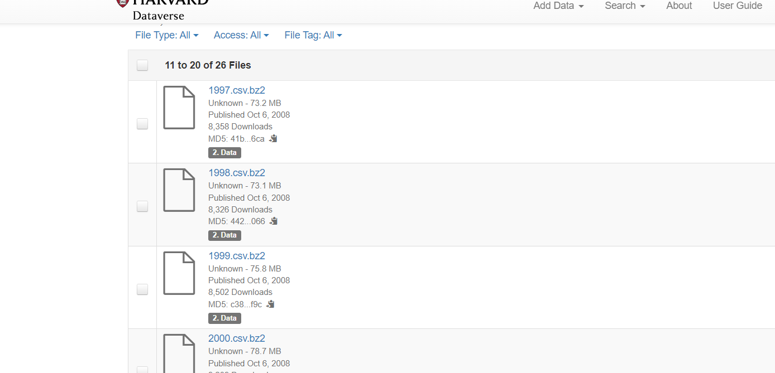
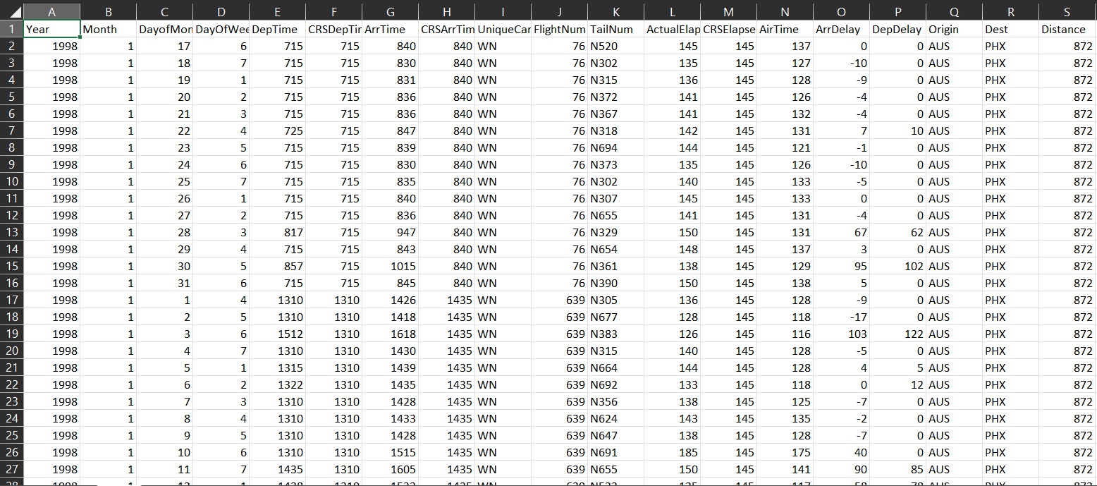
Year: 1998

Slide 15
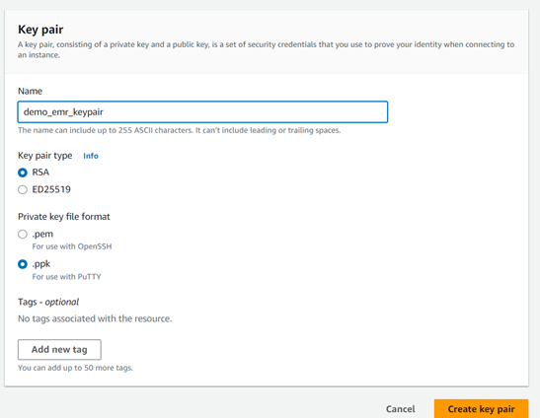
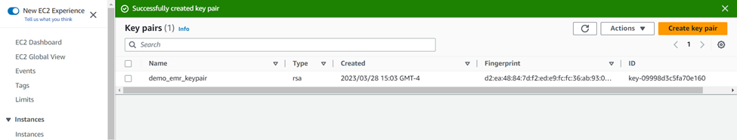

Slide 16
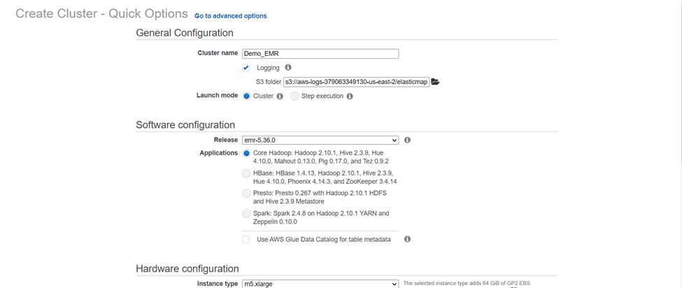
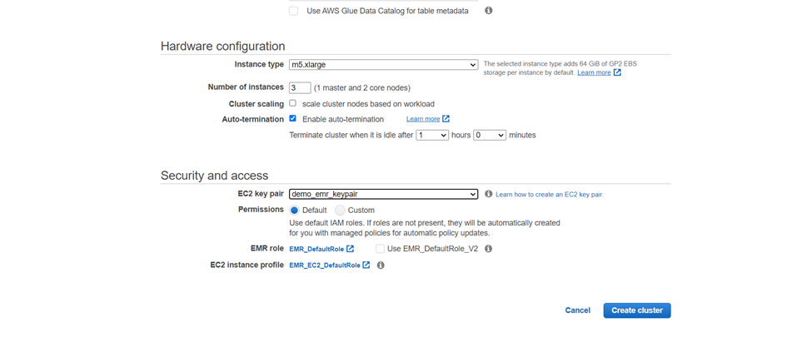

Slide 17
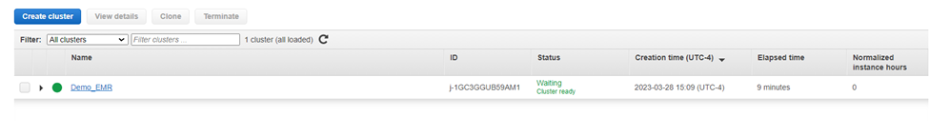
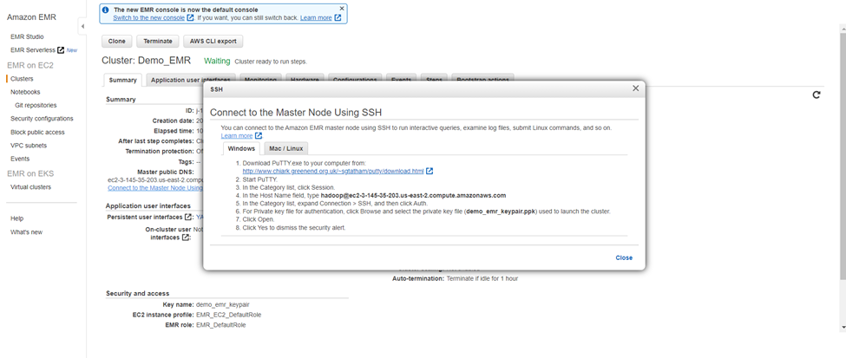

Slide 18


Slide 19
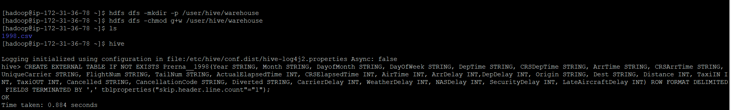
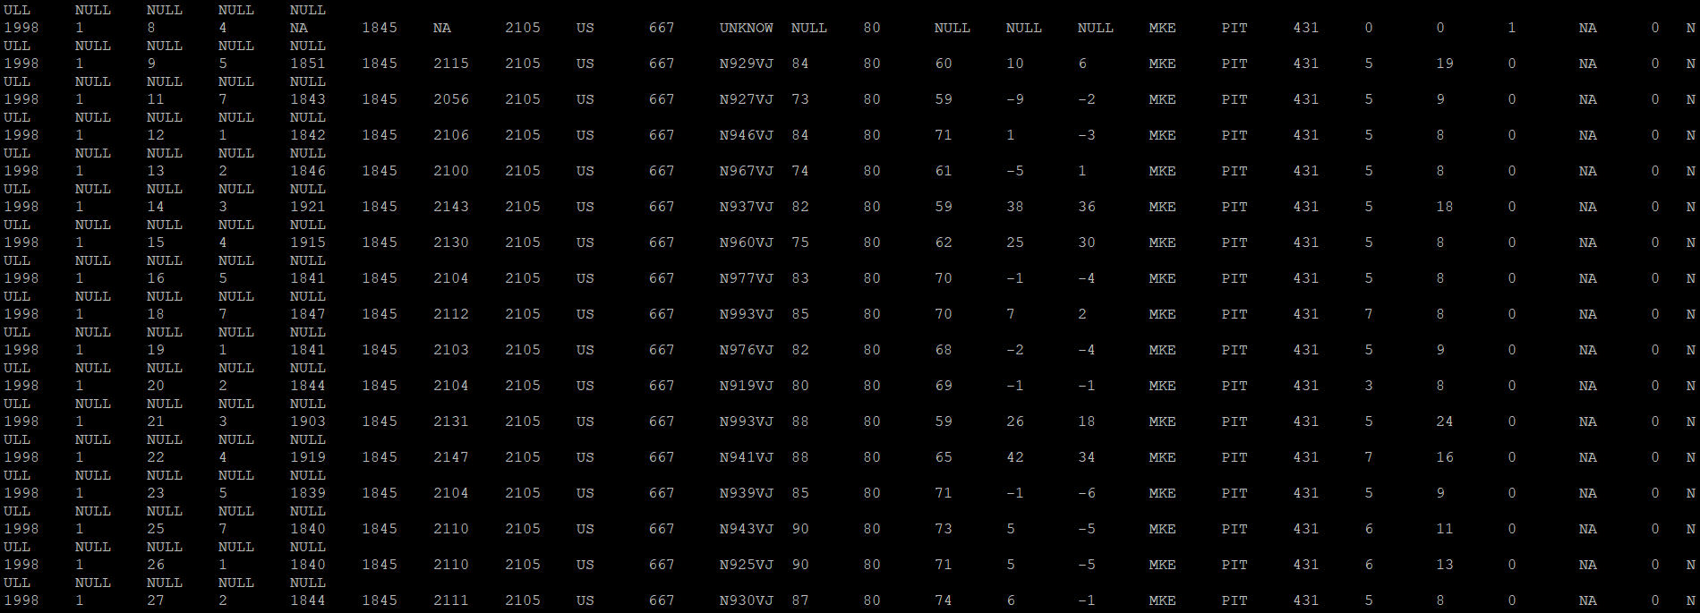
Hadoop table and load all the file data into it also Created a new table and loaded .csv file in it.

Slide 20
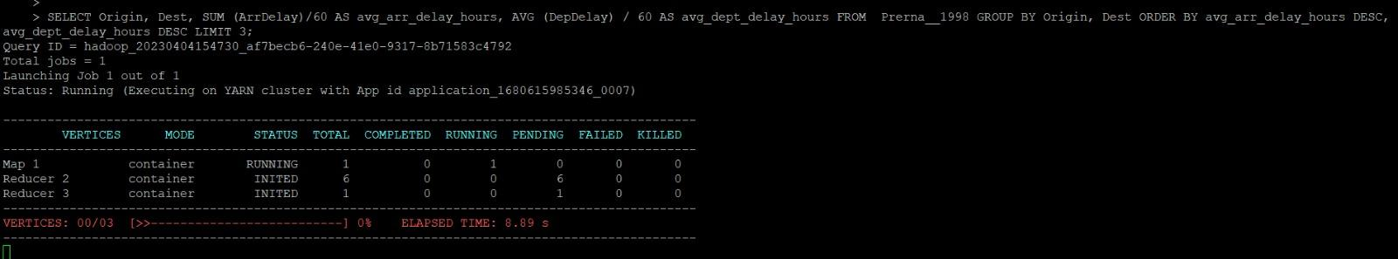
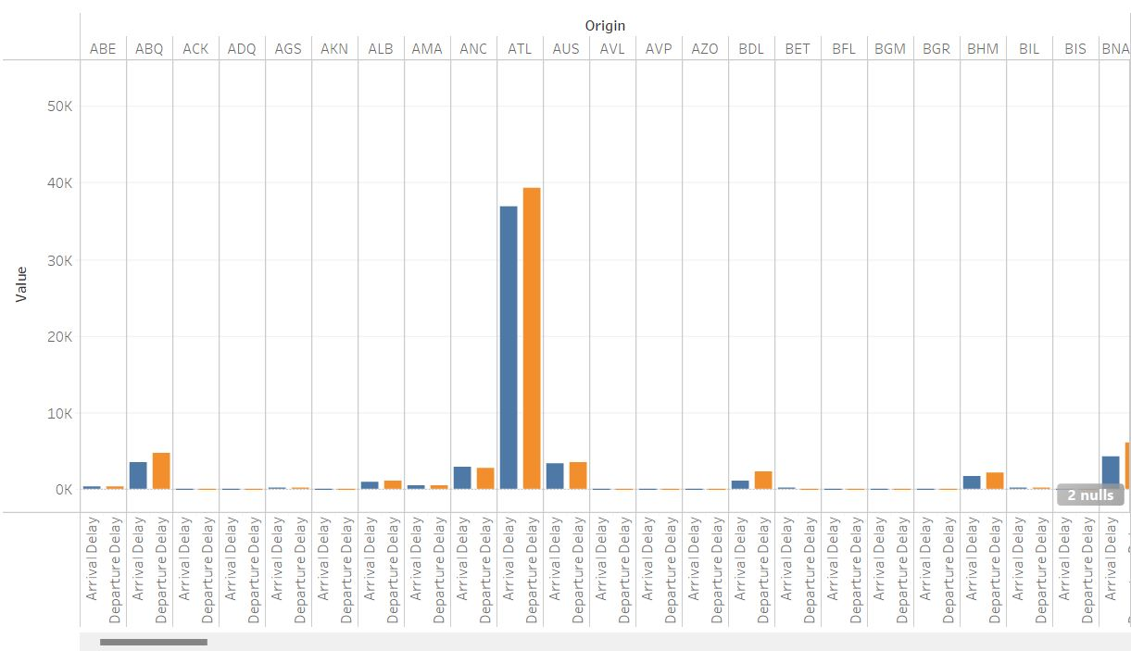
Determine the three airports with the highest delay time (in hours)

Slide 21
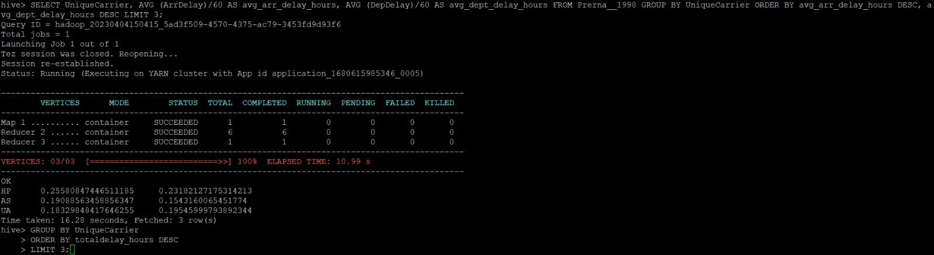
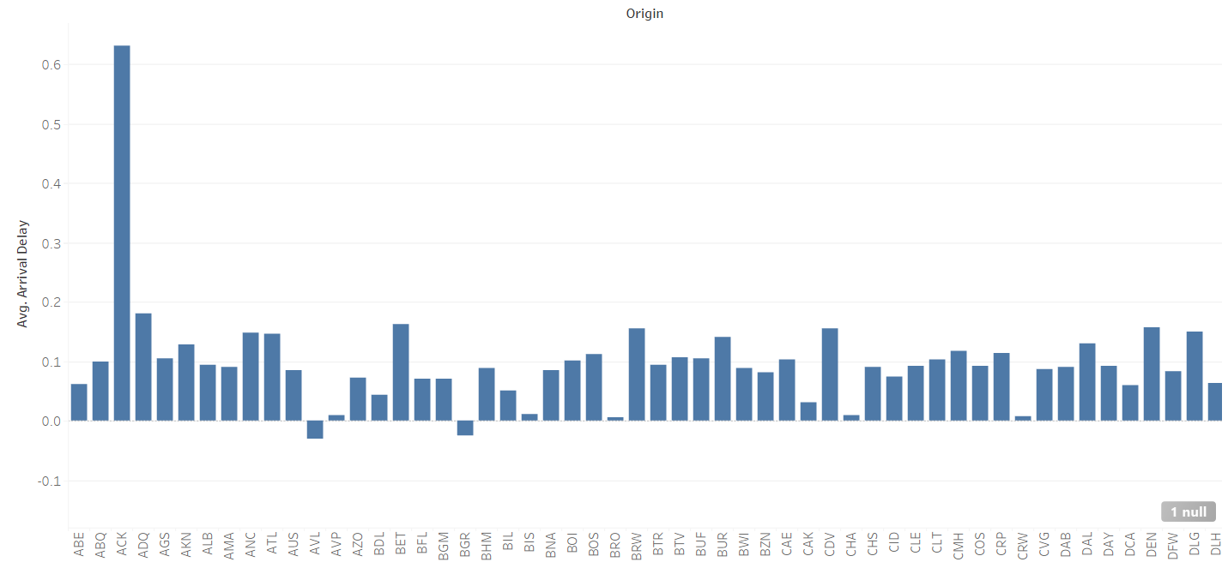
2. Determine the three carriers with the highest delay time (in hours).

Slide 22

3. Determine overall which type of delay (arrivals or departures) is the largest for your carriers

Slide 23


Slide 24
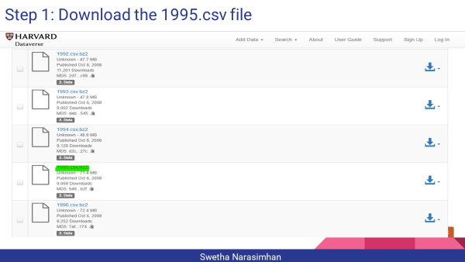

Slide 25
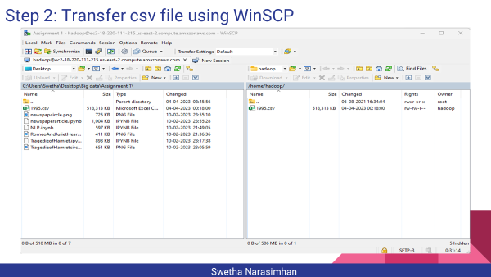

Slide 26


Slide 27
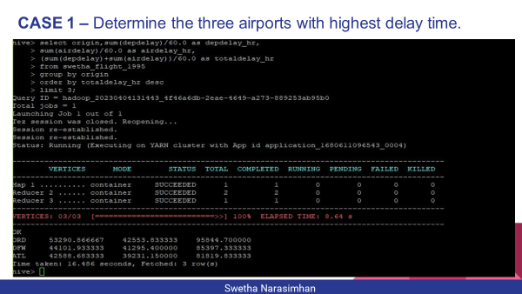

Slide 28
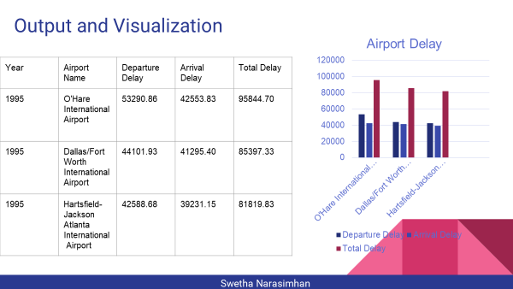

Slide 29
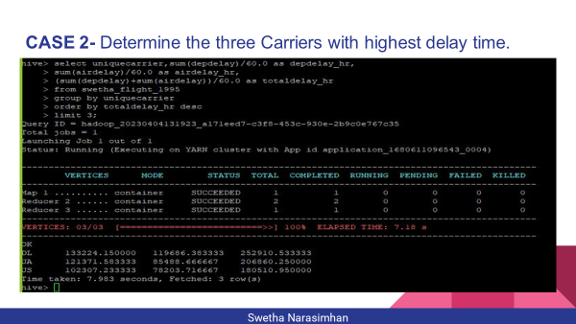

Slide 30
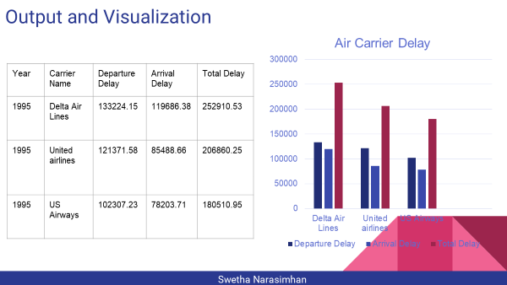

Slide 31
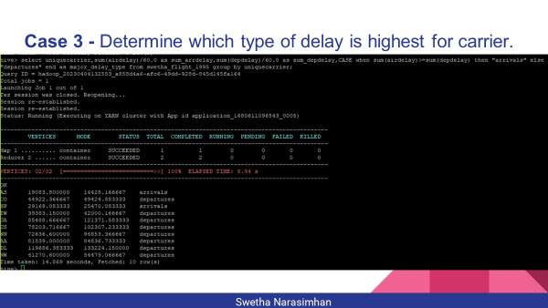

Slide 32
Name : Sejal Arora
Year: 2000

Slide 33
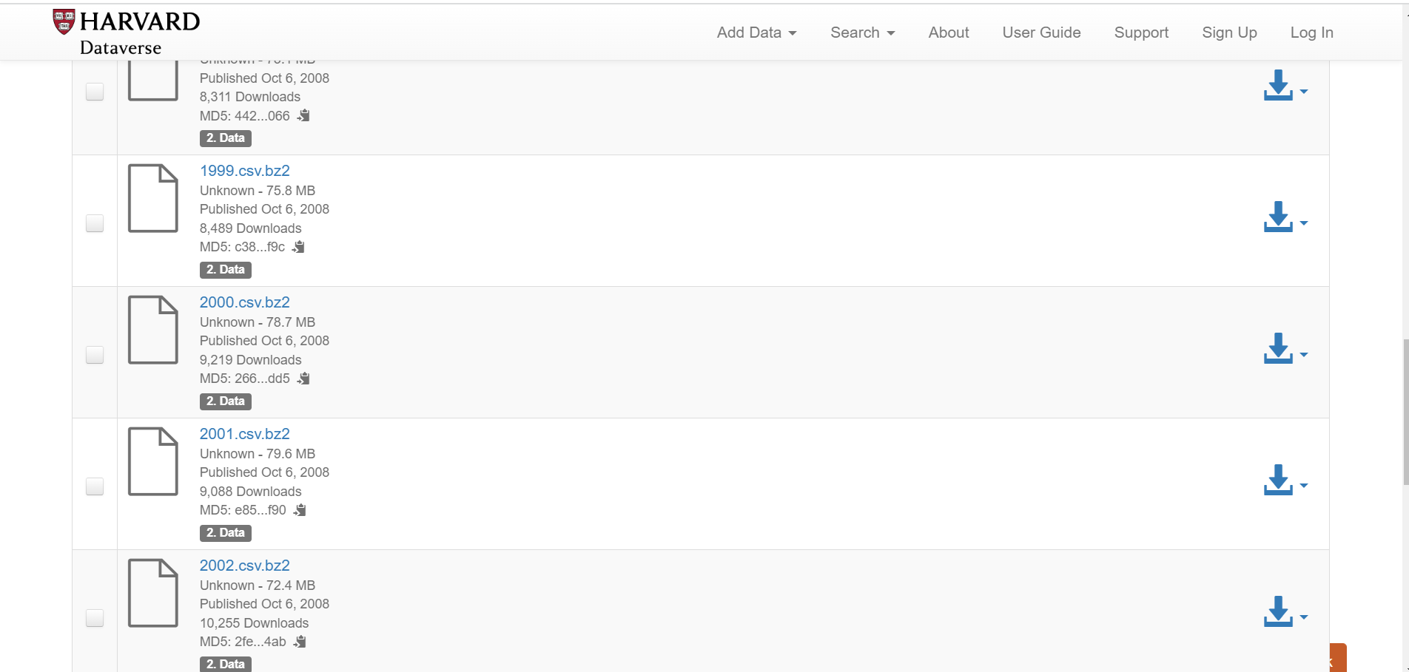
Step 1: Download the 2000.csv file
Sejal Arora

Slide 34
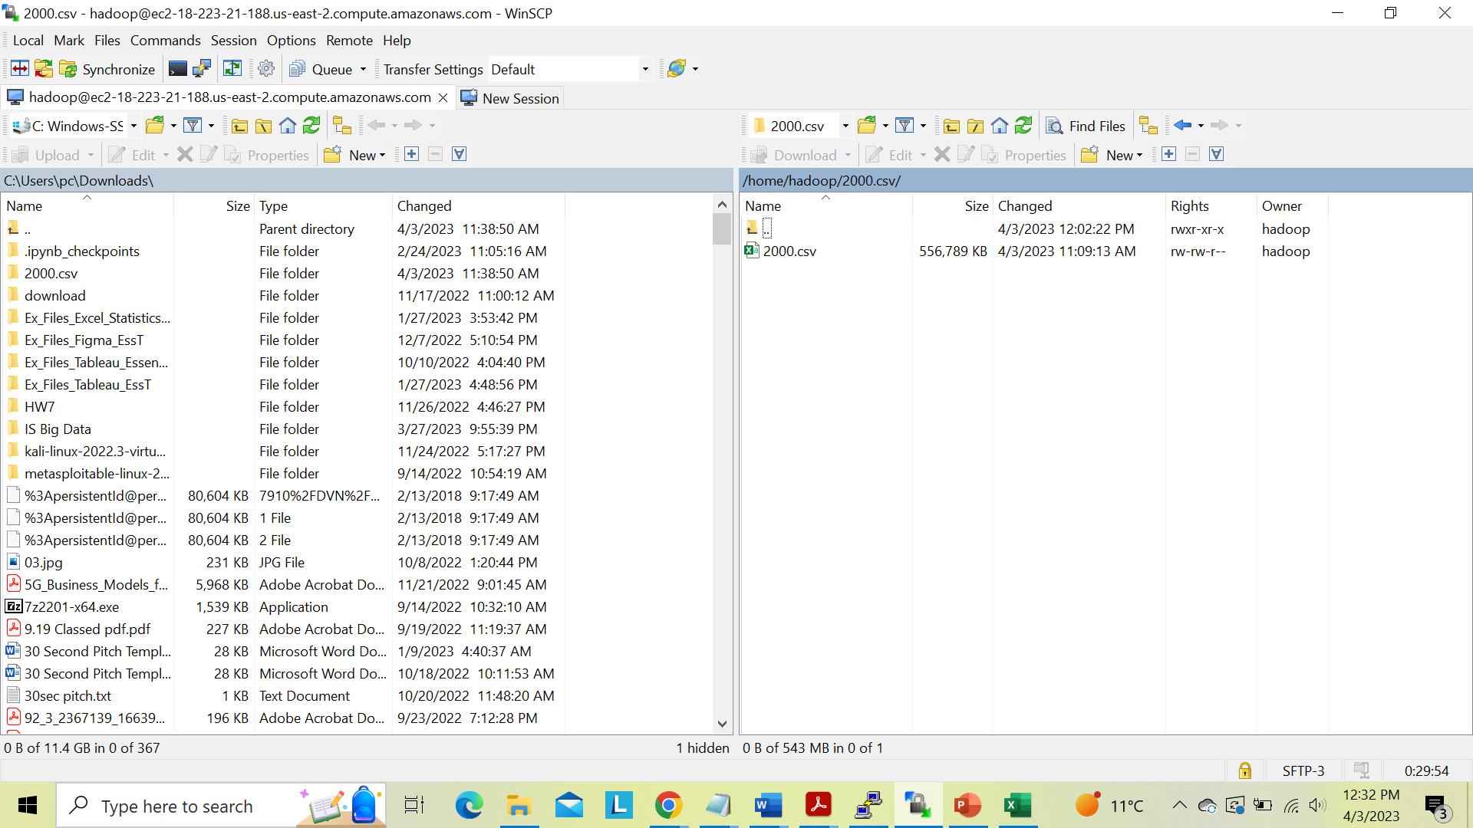
Step 2: Transfer csv file using WinSCP
Sejal Arora

Slide 35
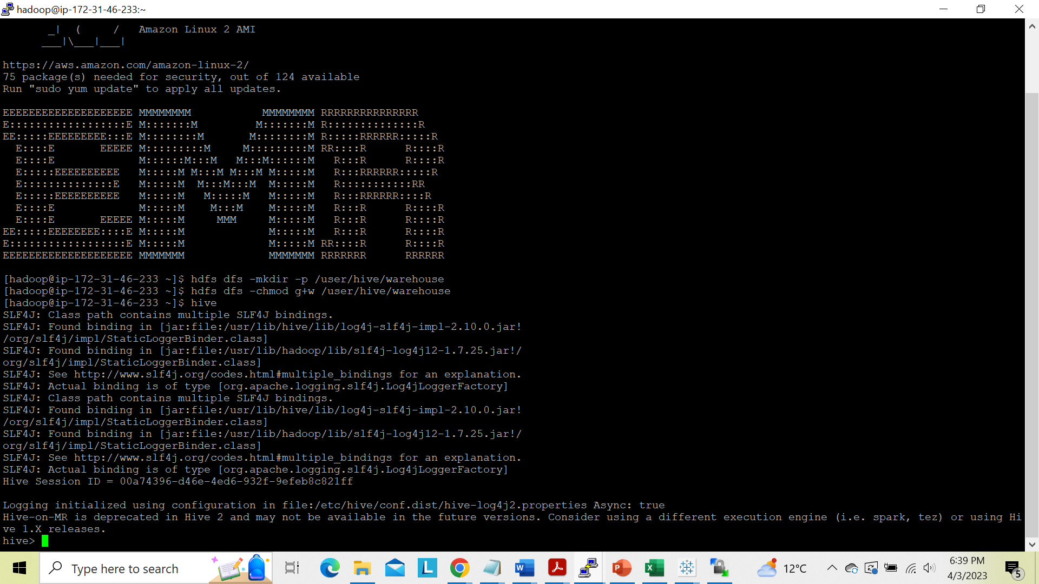
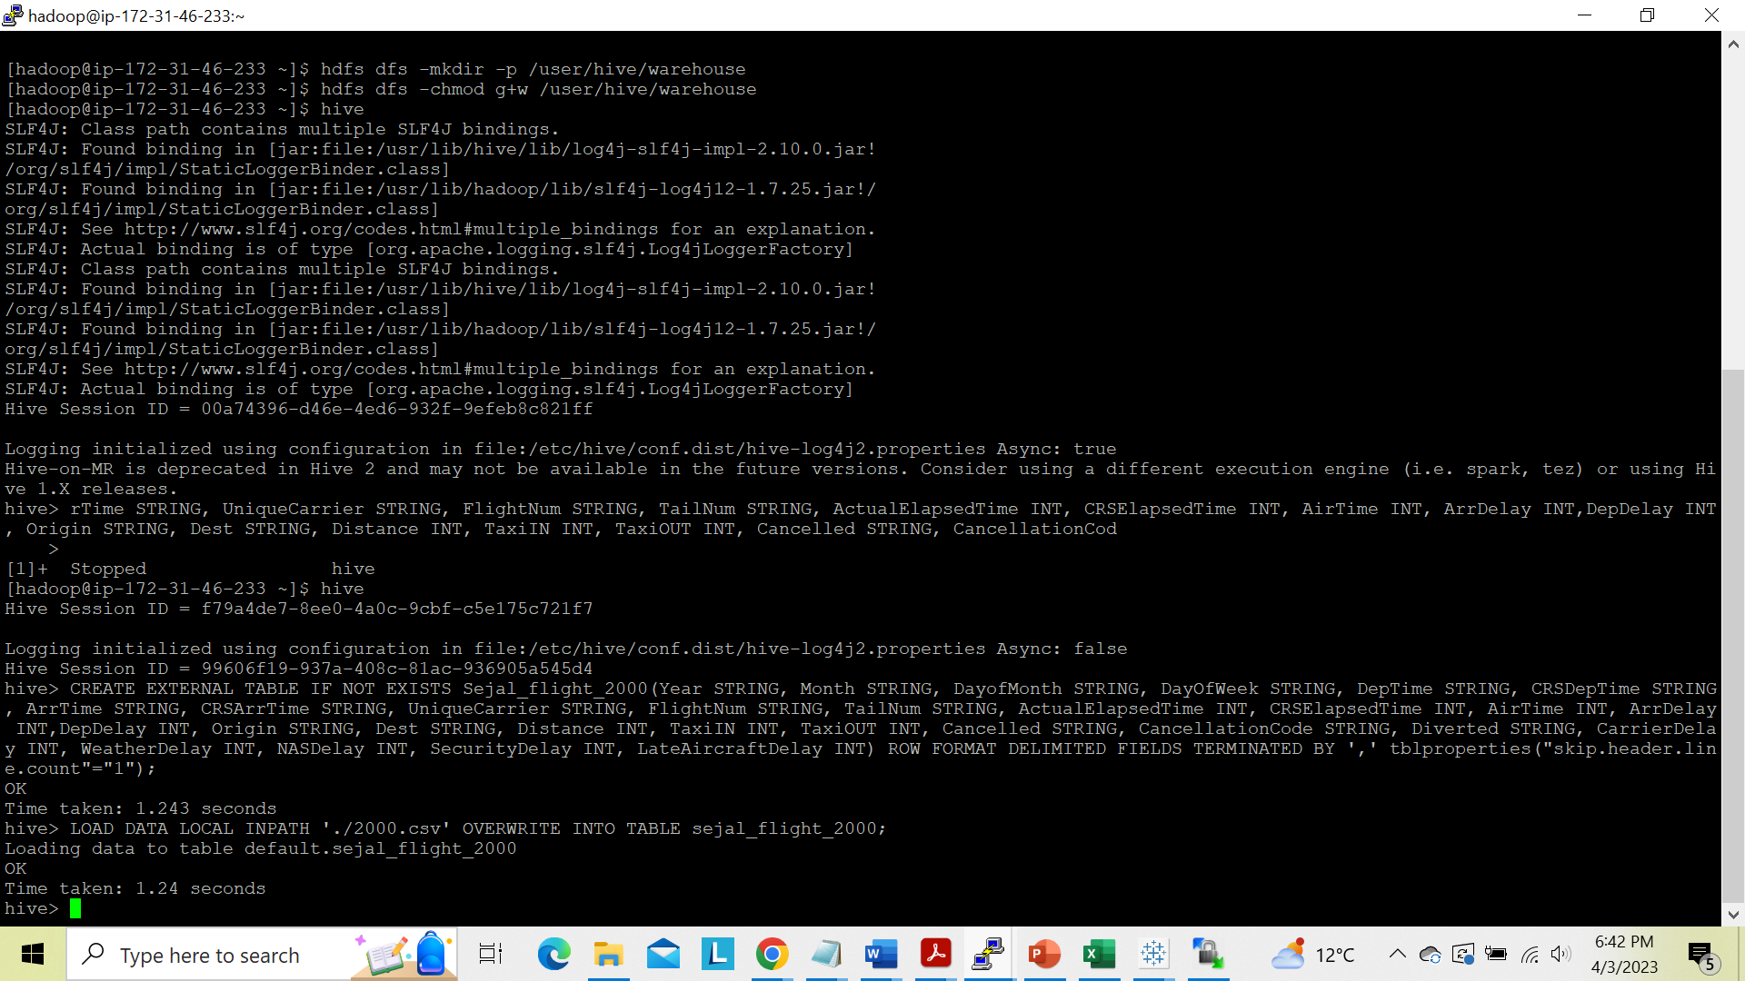
Step 3: Create a Hadoop table and load all the file data into it.
Sejal Arora

Slide 36
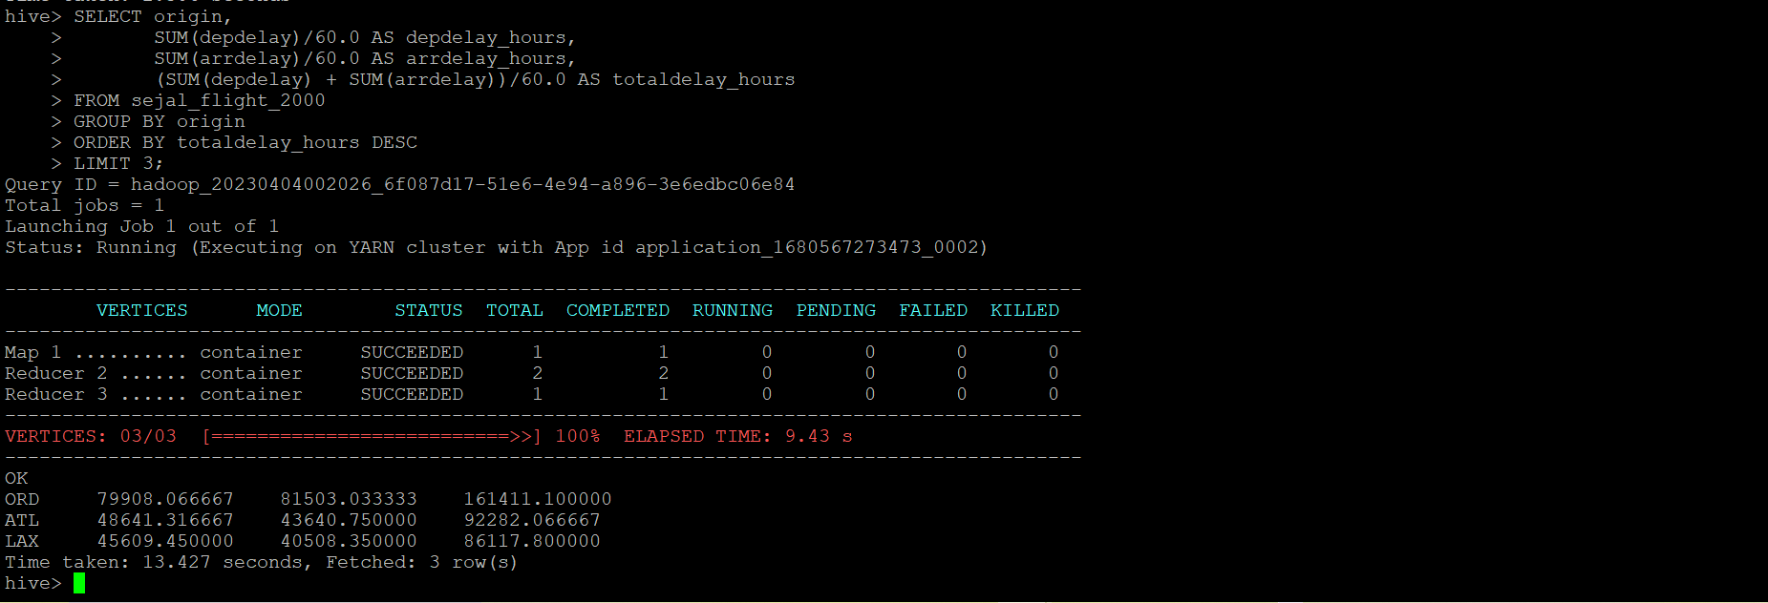
CASE 1 – Determine the three airports with highest delay time.
Sejal Arora

Slide 37
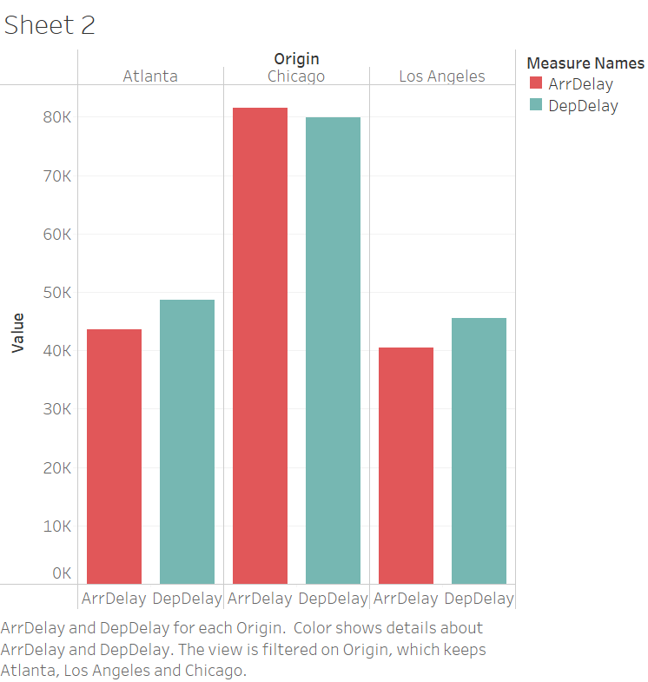
Output and Visualization
Year | Airport Name | Arrival Delay | Departure Delay | Total Delay
2000 | Chicago O'Hare International Airport | 81503 | 79908 | 161411
2000 | Jackson Atlanta International Airport | 43640.75 | 48641.31 | 92282
2000 | Los Angeles International Airport | 40508.35 | 45609.45 | 86117.8
Sejal Arora

Slide 38
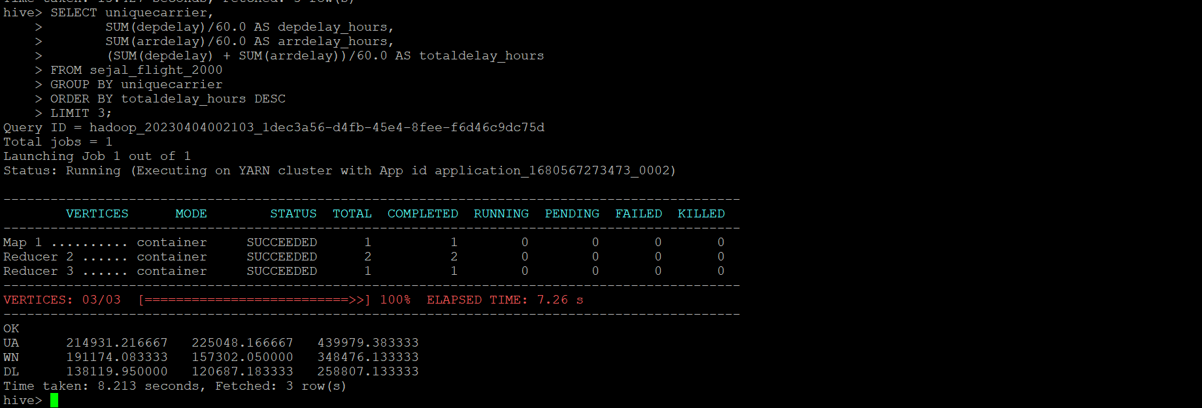
CASE 2- Determine the three Carriers with highest delay time.
Sejal Arora

Slide 39
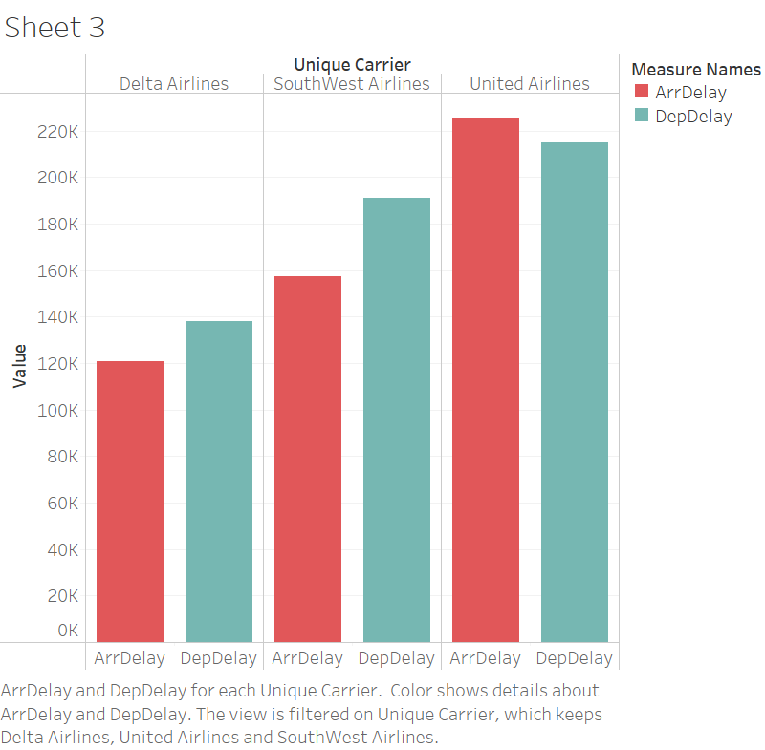
Output and Visualization
Year | Carrier Name | Arrival Delay | Departure Delay | Total Delay
2000 | United Airlines Inc | 225048.16 | 214931.21 | 439979.38
2000 | SouthWest Airlines Co. | 157302 | 191174 | 348476
2000 | Delta Airlines Inc | 120687 | 138119.95 | 258807
Sejal Arora

Slide 40
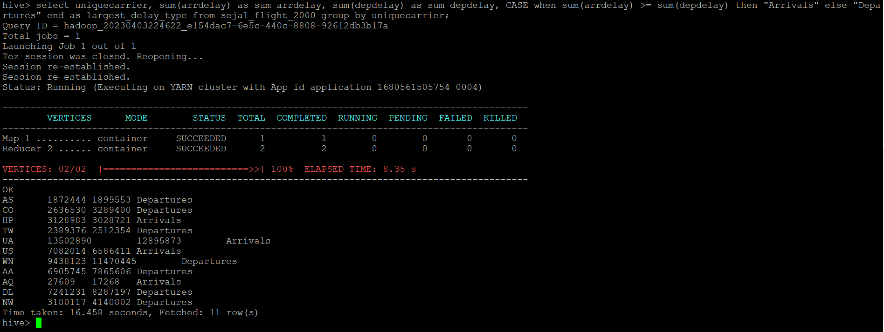
Case 3 - Determine which type of delay is highest for carrier.
Sejal Arora

Slide 41
Conclusion
Chicago O'Hare International Airport has the highest total delay time.
United Airlines carrier has the highest total delay time
Departure delays are the highest for the carriers.

Slide 42


